Slide 1
Docker
Hello Ground!

Slide 2

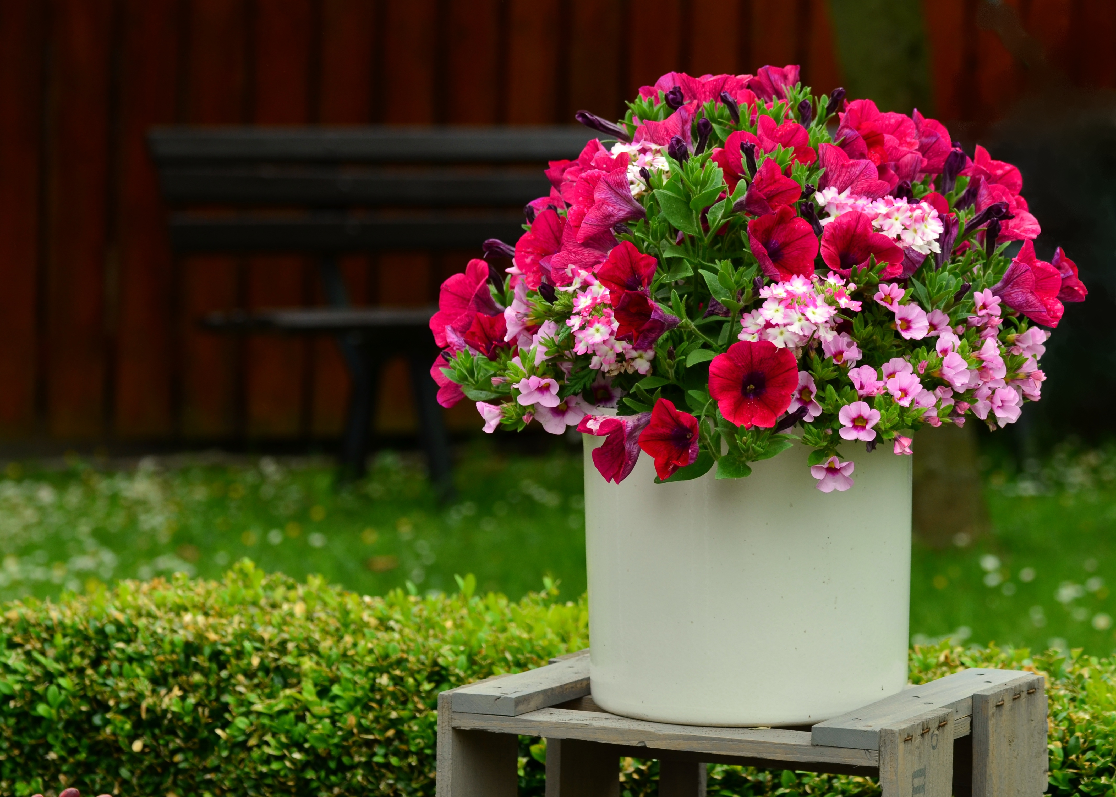
OH NO! NOT AGAIN!

Slide 3

Who Am I
Started with Docker end of 2013
Learned a lot by building and maintaining the OpenNMS Docker Images on DockerHub
Interested in reliability engineering and monitoring
Full time contributor at The OpenNMS Group, Inc.
Learned a lot at the Fulda University of Applied Sciences
Notes:
Working for The OpenNMS Group, Inc. with thanks to all customers who allow me to contribute full time to an Open Source project.
I want to look at awesome amazing technology from a German perspective, which is no fun at all.

Slide 4
Why Containers?
Changes from a machine-centric view to an application-centric view
Resource & Performance Isolation
Efficiency

Slide 5
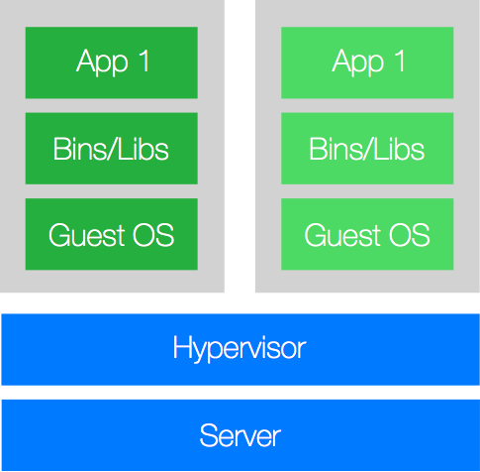
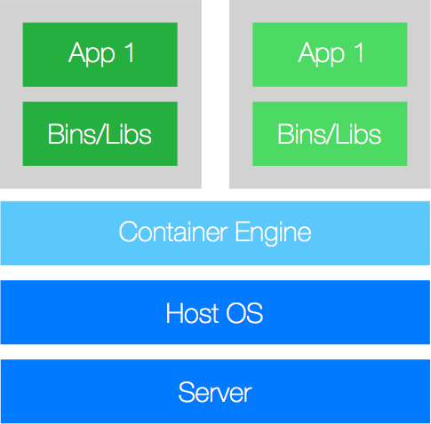
VM vs. Containers

Slide 6
Why Docker?
It was the first ecosystem which provided the full package
Image management
Resource-, File System-, Network-Isolation
Change Management
Sharing
Process Management
Service Discovery

Slide 7
There are others
rkt
LXC/LXD
… probably more

Slide 8
You can see a Container Image as a static linked binary.

Slide 9
Configuration Patterns
Injected as environment variables
Injected as file
You can bake it in your container
Secrets -> as volume mount or environment variable

Slide 10
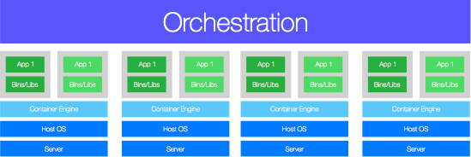
Container Orchestration

Slide 11
Orchestration
Docker Swarm - Docker Inc., APL 2.0
Kubernetes - Cloud Native Computing Foundation, APL 2.0
OpenShift or OKD (the Origin community Distribution of Kubernetes), APL 2.0
Apache Mesos - Apache Software Foundation, APL 2.0
Nomad - HashiCorp, MPL 2.0
Notes:
Abstract CPU, memory, storage, and other compute resources away from machines.

Slide 12
You can imperatively change a running container. This is an anti-pattern. Immutable containers are the core of everything you will build using something like Kubernetes.

Slide 13
Migrating a Legacy Java Application to Docker

Slide 14

Notes:
So now you know all these things, everything make sense and you are a happy and you can't wait to enjoy the ride ...

Slide 15

Notes:
... but this is what you really get. There is no way to stay clean. The reason is very simple. Running applications in Container Orchestration infrastructure implies the software behaves in certain ways. Legacy apps just the f*ck don't care about immutability and declarative configurations and there is Java ...
Start with things you know + extend with what you don't know. Ok first things first start small - Docker and Docker compose and synchronise with reality.

Slide 16
Getting Started
Docker for your operating system, works best on Linux
Docker Compose, declarative way to describe a service stack
Internet connectivity
A DockerHub Account
https://github.com/indigo423/ouce2018

Slide 17
Docker 101
ENTRYPOINT vs. CMD?!
Pid 1: Orphanes, Zombies and Signals
Notes:
Pid 1 normally init has special functions, adoption of orphaned child processes, singling and reaping zombies. You can have corner cases where you run in problems.

Slide 18
Entrypoints in Docker
Demo 1
Notes:
Demo 1

Slide 19
Java 8 and Docker aren't friends out of the box. Container love for Java is added in 9 and 10
Notes:
Pid 1 normally init has special functions, adoption of orphaned child processes, singling and reaping zombies. You can have corner cases where you run in problems.

Slide 20
Java in Docker - Memory
Docker can set memory and CPU limitations that Java can’t automatically detect
Limit a container to get only 100MB of memory, Java before 8u131 doesn’t see this limit
Backported to Java 8u131 onwards -XX:+UnlockExperimentalVMOptions \ -XX:+UseCGroupMemoryLimitForHeap
Java 10+ are the new defaults

Slide 21
Java in Docker - CPU
JVM will look at the hardware and detect the amount of CPU’s
Docker might not allow you to use all these CPUs
Not back-ported to Java 8 or Java 9, it was tackled in Java 10 (JDK-8146115)
--cpus=“.5” or --cpuset-cpus=”0-3”

Slide 22
More in detail …
Java and Docker the Limitations
Docker and the PID 1 zombie reaping problem
Is Docker eating Java Lunch

Slide 23


Slide 24
Building Blocks
CentOS 7
OpenJDK
https://github.com/opennms-forge/docker-openjdk
Horizon
https://github.com/opennms-forge/docker-horizon-core-web
Notes:
Use what is there, vanilla CentOS 7 image maintained by the CentOS project.
We add an intermediate image to have control about the OpenJDK version. By default we use latest, just in case we can roll back or pin it to a specific version if necessary. We use the same OpenJDK image also for Minion.

Slide 25
Building Blocks
CentOS 7
OpenJDK
Horizon
https://github.com/opennms-forge/docker-horizon-core-web
Notes:
It runs just the OpenNMS Horizon application with the OpenNMS owned daemons and a Karaf OSGi container. OpenNMS Horizon needs PostgreSQL. Ok I have the Horizon Docker Image as an artefact, what should we do next? You can't run it standalone, OpenNMS Horizon requires PostgreSQL as a database.

Slide 26
Building Blocks
Horizon
PostgreSQL
RRD Files
Database
Configuration
TCP/8980
TCP/5432
Notes:
A composition of two services and some volumes to persist data. We can use the vanilla PostgreSQL image maintained by the PostgreSQL community. When you start with Docker, don't care about orchestration and start small. What do you need to run and build your first Docker application stack is Docker and Docker Compose.

Slide 27
Minimal Setup
Browser
Horizon
TCP/8980
TCP/5432
PostgreSQL
Notes:
We do not publish PostgreSQL port to the outside world and let just OpenNMS Horizon use it. We publish TCP 8980 on Horizon to access the web application.
Embedded DNS server which provides built-in service discovery for any container created with a valid name or net-alias or aliased by link

Slide 28
Demo 2 - Hello OpenNMS
Notes:
Demo 2

Slide 29
Important
docker-compose stop vs. docker-compose down
docker-compose stop -> Docker persists every file system even a container exits!
docker-compose down -> docker-compose stop && docker-compose rm
Notes:
Demo 2

Slide 30
Steps to build
Docker Compose file with two services Postgres and Horizon
Initialize postgres with a root password
Configure a database user for OpenNMS and the root password to initialise the database
Publish port 8980/TCP
Persist Postgres database, OpenNMS RRD and OpenNMS config
Notes:
Demo 2

Slide 31
OpenNMS Horizon Configuration

Slide 32
Demo 3 - Configs
Notes:
Demo 2

Slide 33
Different ways
Start-up configuration in opennms.properties.d
This is about Runtime configuration
You have to edit files
Be aware some configuration files can be changed in the WebUI or from REST, they need to be persisted

Slide 34
Configs changed in the Filesystem
On startup we check if there is anything in these directories and overwrite whats in /opt/opennms/etc
/opt/opennms-etc-overlay
/opt/opennms-jetty-webinf-overlay

Slide 35
Upgrade the OpenNMS Horizon

Slide 36
Demo 4 - Upgrade 21.0.3 -> 22.0.3

Slide 37
Demo 4 - Step back What is your change in 21.0.3

Slide 38
Upgrade a configuration
You have to merge your custom configuration
/opt/opennms-etc-overlay
/opt/opennms-jetty-webinf-overlay
configtester in various versions by mounting your config into a docker run --rm -v \ $(pwd)/your-etc:/opt/opennms/etc \ opennms/horizon-core-web:22.0.3-1 -t -a

Slide 39
Upgrade a configuration
You can initialise a pristine config from GitHub https://github.com/OpenNMS/opennms-etc-pristine
You can use the config init from the container image
diff -rq -EBbw old-cfg new-cfg

Slide 40
Docker Horizon Image
Published on DockerHub: opennms/horizon-core-web
Source code: https://github.com/opennms-forge/docker-horizon-core-web
Build with CircleCI: https://circleci.com/gh/opennms-forge/docker-horizon-core-web
Learn and share
Demo: https://github.com/indigo423/ouce2018

Slide 41
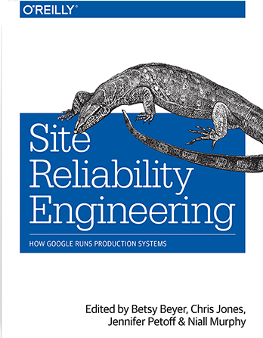
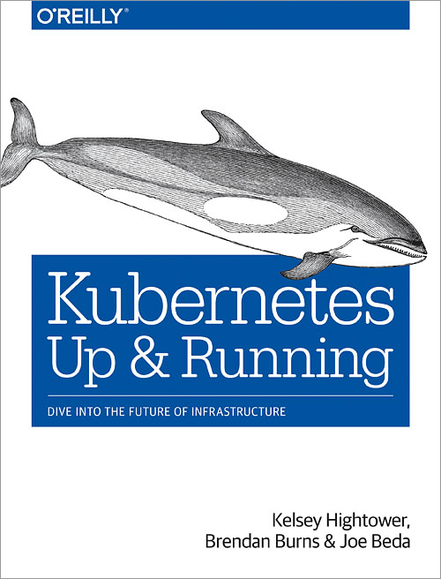
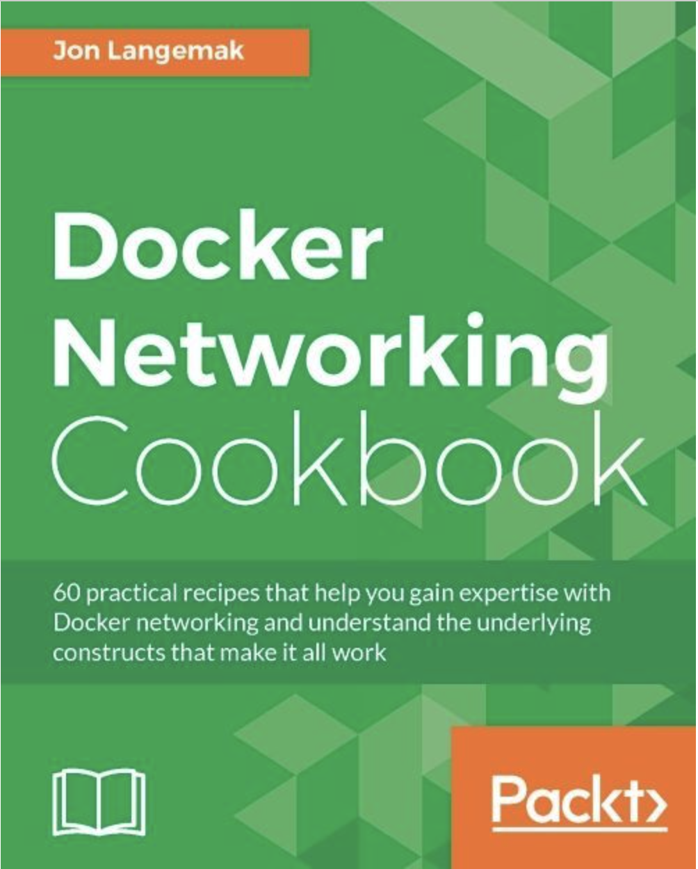

Slide 42
BACKUP

Slide 43
Logging

Slide 44

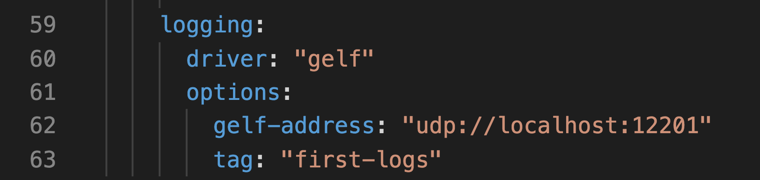
Docker output

Slide 45

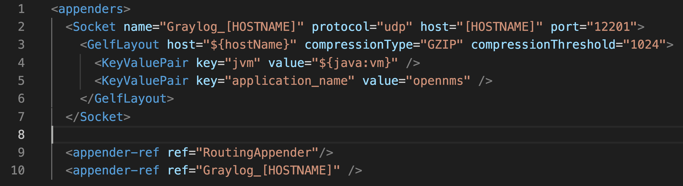
OpenNMS Horizon Logs
https://wiki.opennms.org/wiki/Sending_OpenNMS_Logs_to_Graylog

Slide 46

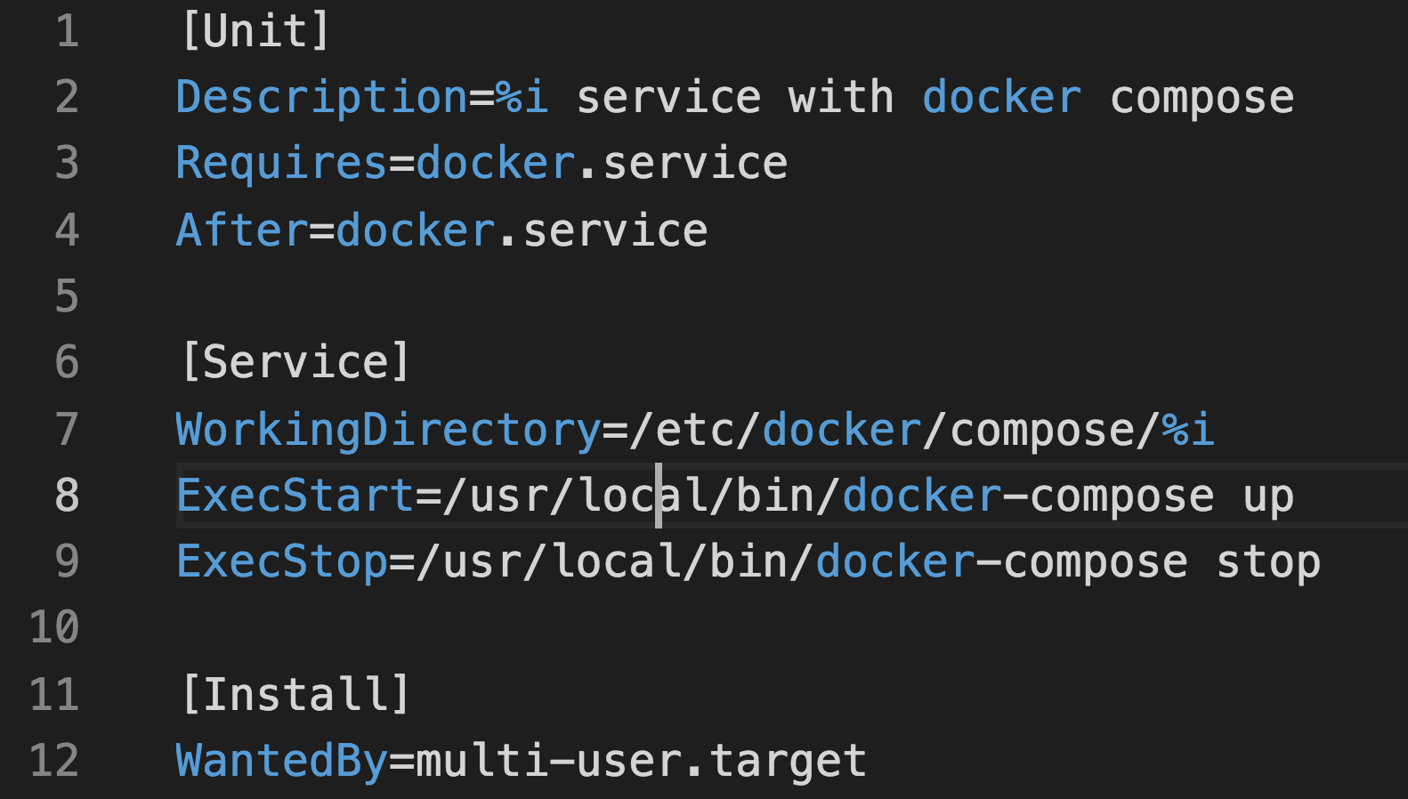
Poor Mans Container Service
systemctl [start | stop] docker-compose@<myApplication>

Slide 47
Containers and Performance
IBM Research Report An Updated Performance Comparison of Virtual Machines and Linux Containers
"Although containers themselves have almost no overhead, Docker is not without performance gotchas. Docker volumes have noticeably better performance than files stored in AUFS. Docker’s NAT also introduces overhead for workloads with high packet rates. These features represent a tradeoff between ease of management and performance and should be considered on a case-by-case basis."

